Slide 1

AI-Sandbox: Rugulopteryx OKamurae
Detecting and Early Detection of the Invasive Species RO
—A Graph-Based Machine Learning Approach for Global Ecological Monitoring

Slide 2
Catalogue
Introduction
Detection
Early Detection
Discussion & Conclusion
Notes:
Introduction (summary)
Detection (Computer vision-CNN-RS, Environmental Conditions-based Risk Quantification)
Early Detection(temporal-GNN, posterior prediction)
Conclusion and discussion (Implementation recommendations, Own data only, OS data only, hybrid data source)

Slide 3
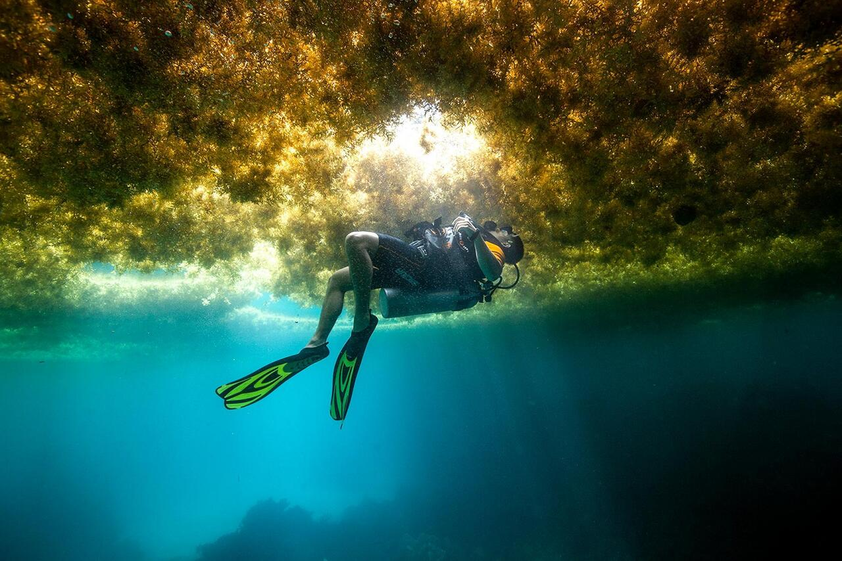
Introduction – The Challenge
Issue:
Rugulopteryx okamurae (RO) is a rapidly spreading invasive species threatening marine ecosystems.
Traditional monitoring methods are limited by scale, resolution, and timing.
Goal:
Develop an early detection system to identify and predict RO spread across multiple regions.
https://www.firmm.org/en/news/article/items/rugulopterix-okamurae-or-how-ecosystems-collaps

Slide 4
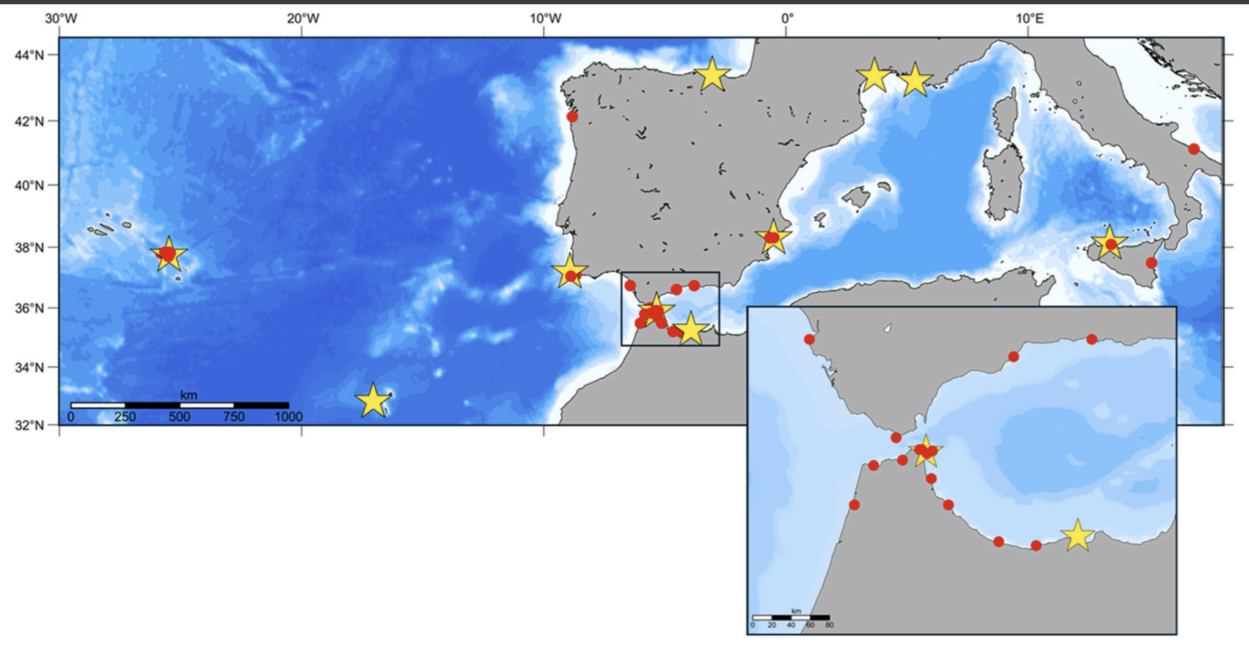
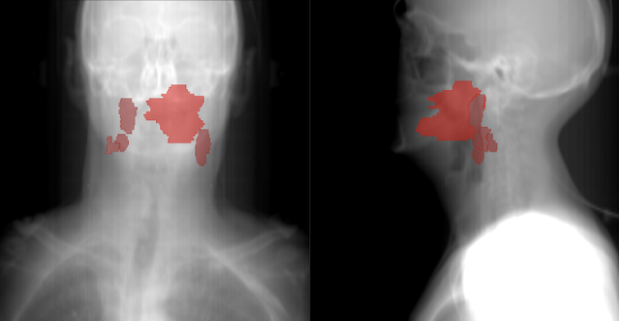
Introduction
– The Inspiration
Cancer Spread Model:
Inspired by graph-based cancer imaging models, which link: Tumor spread patterns & Connectivity between lymph nodes.
RO Spread Model:
With further evidence of other successful use cases of GNNs for spatio-temporal progression modelling = our core problem (e.g. disease spread) as well as some basic experimental evidence, we decided to go with this approach.
Top: https://doi.org/10.1016/j.marenvres.2025.107093.
Bottom: Kazmierski, M. and Haibe-Kains, B., 2021. Lymph node graph neural networks for cancer metastasis prediction. arXiv preprint arXiv:2106.01711.

Slide 5
Introduction – The Methodology
Graph-Based Detection Approach:
Build a graph model representing RO spread across three global Regions of Interest (ROIs)
Incorporate:
Imaging characteristics from satellite data
Spatial relationships between RO-affected sites
Predict RO presence and spread patterns via Graph Neural Networks (GNNs)
Pipeline:
Satellite data → Cropping → Graph construction → GNN model → Prediction

Slide 6
Introduction –Datasets Overview
Observation Dataset:
Binary record (presence/absence of RO)
Satellite Dataset:
3-band imagery from 3 global ROIs
Simplest Implemented Model:
Match datasets using geolocation (lat-long)
Crop satellite images into 64×64 pixel patches centered on observation points
Use cropped images as inputs to CNN for prediction
Proposed Model:
ROST Detection Model (GNN)

Slide 7
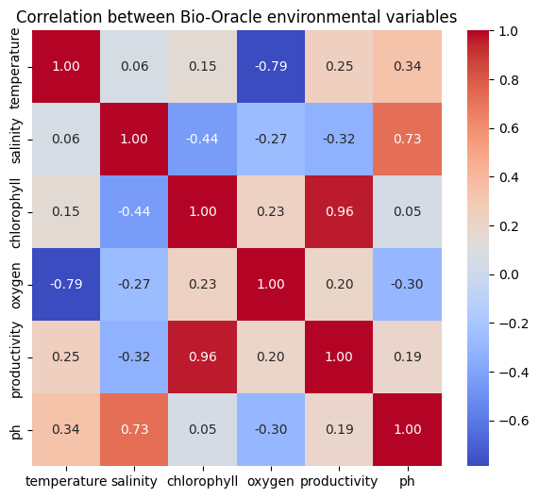
Detection
–Environment Condition-based Risk Model
Environmental Conditions Extraction
Notes:
Environmental variables (SST, salinity, chlorophyll, etc.) were extracted from Bio-Oracle rasters for each observation point to characterize habitat conditions.

Slide 8
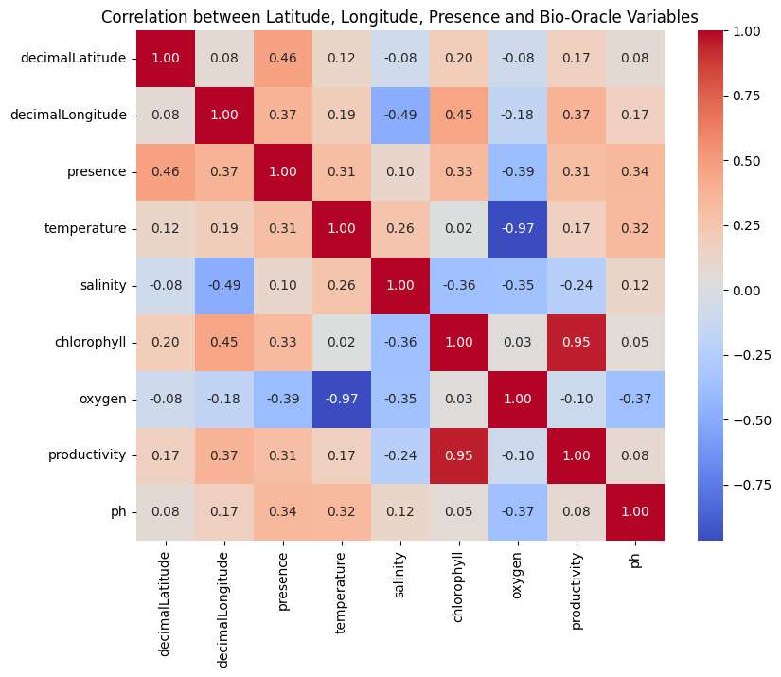
Detection
–Environment Condition-based Risk Model
Detection of Suitable Environmental Conditions
Notes:
correlating environmental variables with species occurrence data, we identified environmental profiles favorable to Rugulopteryx okamurae.
the continuous environmental variables are not discretized.
The correlation between a binary variable (presence = 1, absence = 0) and continuous variables (e.g., temperature, salinity, etc.) is typically computed using a point-biserial correlation, which is mathematically a special case of Pearson’s correlation coefficient.

Slide 9
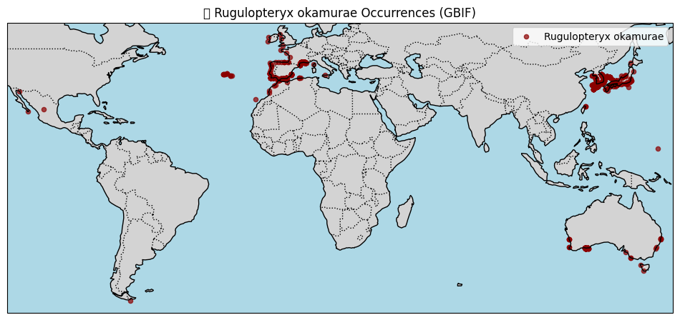
Detection
–Environment Condition-based Risk Model
Notes:
Title: Distribution of Rugulopteryx okamurae (GBIF Data) Explain:
Mapped all occurrence points over world coastlines using Cartopy.
Visualized current known distribution of the species.
Showed its spread along European and Mediterranean coasts.
Adding Pseudo-Absence Points
Title: Creating Background Data for Model Training Explain:
Generated 500 random pseudo-absence points in the same spatial extent (ocean area).
Labeled occurrences as presence = 1, absences as presence = 0.
This allowed training a binary logistic regression model (presence/absence prediction).

Slide 10
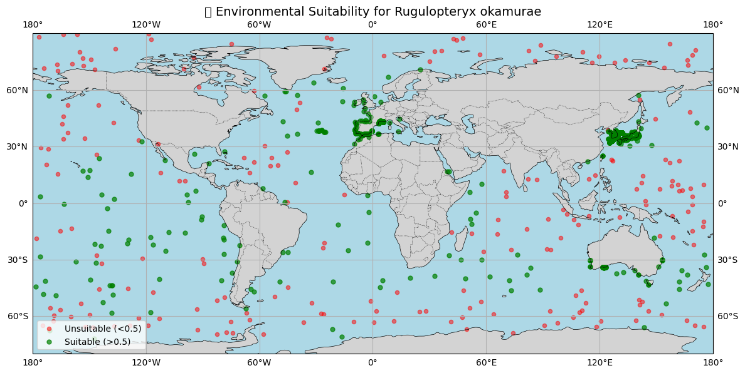
Detection
–Environment Condition-based Risk Model
Suitability Quantification
Notes:
Title: Modeling Environmental Suitability Explain:
Used logistic regression to relate species presence to environmental predictors.
Standardized all predictors before fitting.
Computed coefficients → positive = variable increases suitability, negative = decreases.
Identified which environmental factors most influence presence.
Title: Predicted Suitable and Unsuitable Areas Explain:
Predicted probability of presence (0–1) for each point.
Classified:
Green = Suitable (>0.5)
Red = Unsuitable (<0.5)
Showed where environmental conditions are favorable for colonization.

Slide 11
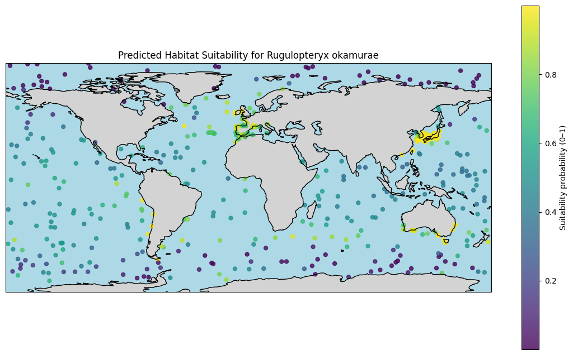
Detection
–Environment Condition-based Risk Model
REWARDING
Risk quantification (Suitability Probability)
Notes:
Title: Modeling Environmental Suitability Explain:
Used logistic regression to relate species presence to environmental predictors.
Standardized all predictors before fitting.
Computed coefficients → positive = variable increases suitability, negative = decreases.
Identified which environmental factors most influence presence.
Title: Predicted Suitable and Unsuitable Areas Explain:
Predicted probability of presence (0–1) for each point.
Classified:
Green = Suitable (>0.5)
Red = Unsuitable (<0.5)
Showed where environmental conditions are favorable for colonization.

Slide 12
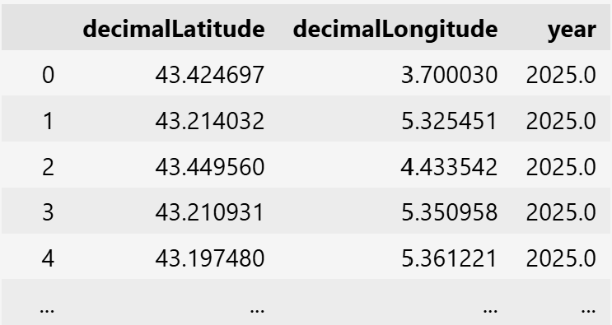
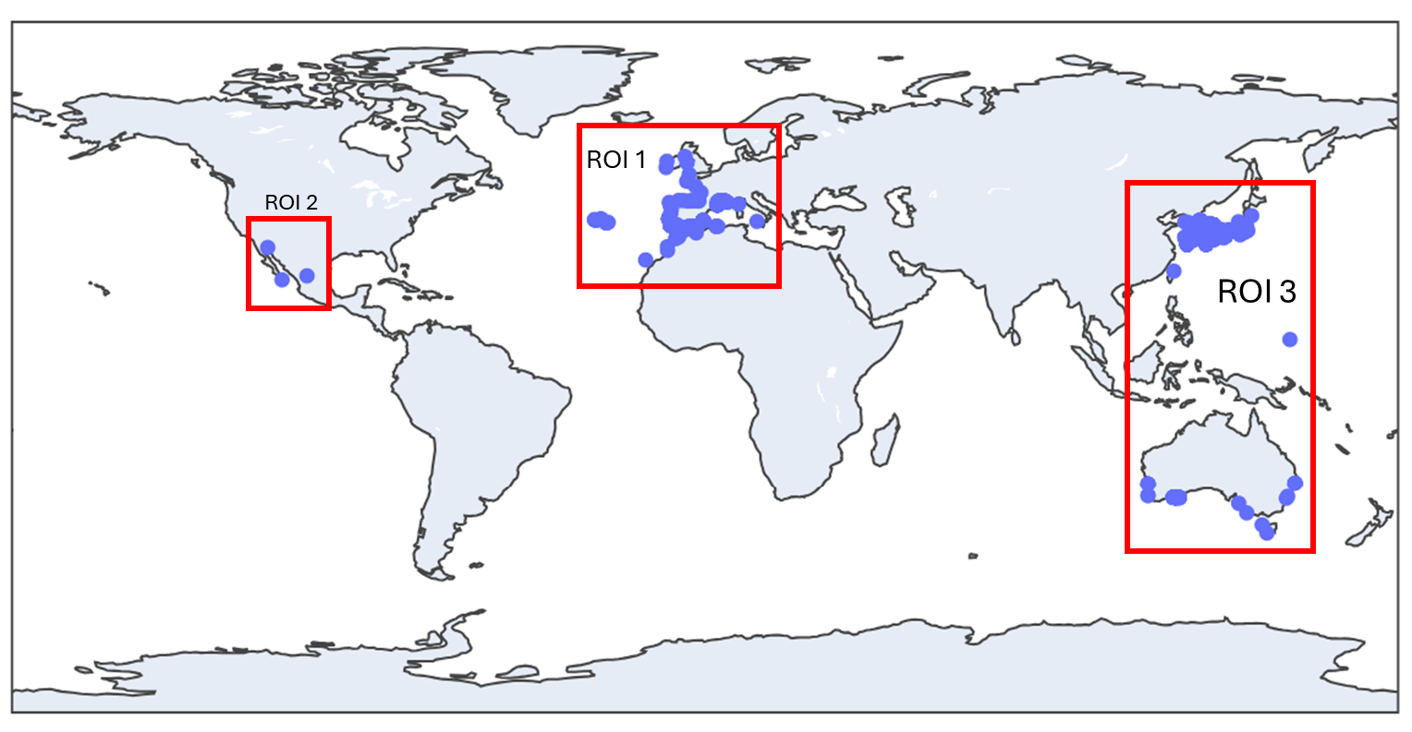
Detection – CNN
Varying Levels of Complexity Possible.
SIMPLEST
GBIF - Global Biodiversity Information Facility
Google Earth Engine - Sentinel-3 OLCI EFR: Ocean and Land Color Instrument Earth Observation Full Resolution.
Mean & SD of 3 Vegetation Focus Bands:
Band 8 - 665nm/10nm
Band 17 - 865nm/20nm
Band 21 - 1029nm/40nm

Slide 13
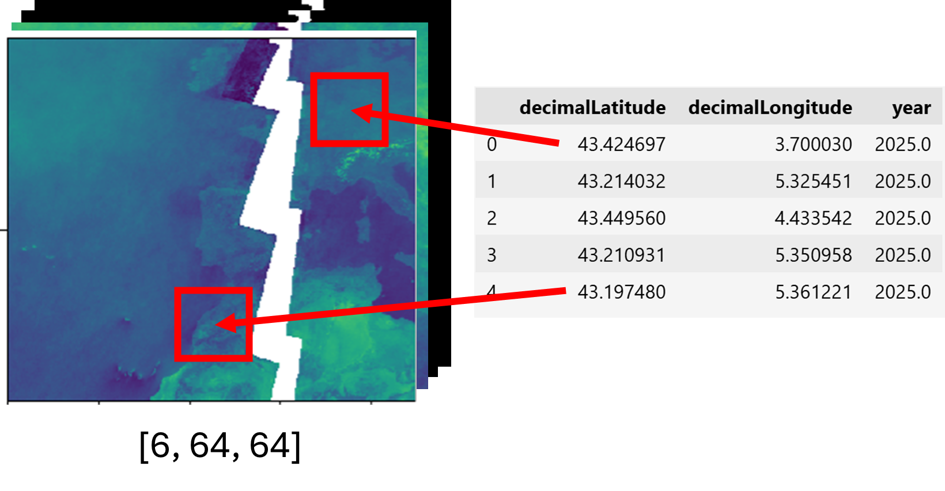
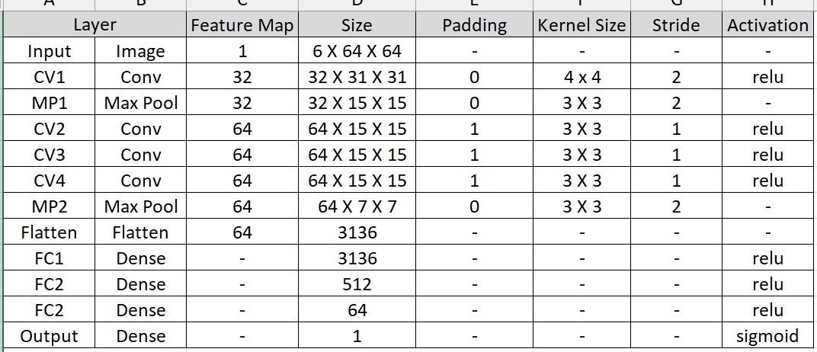
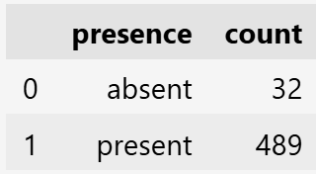
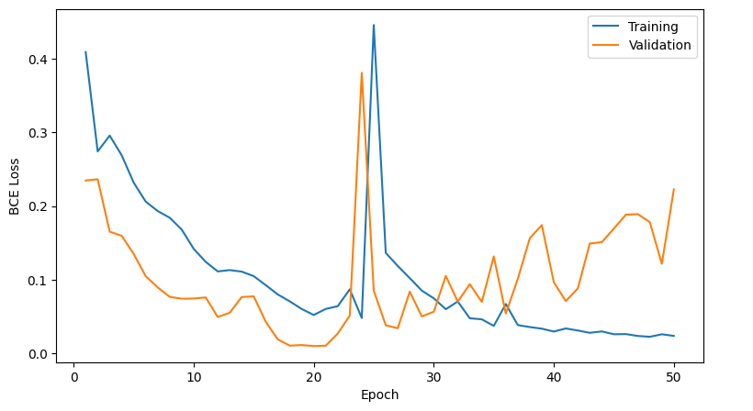
Simple Convolutional Neural Network (CNN)
Trained for 50 Epochs.
Train Test Split: 80 - 10 - 10 %
Loss: Binary Cross Entropy
Learning Rate: 0.001
Optimizer: Adam

Slide 14
BASELINE (ALL ONES) ===
bce loss: 9.4340
precision: 0.9057
recall: 1.0000
f1: 0.9505
accuracy: 0.9057
counts: TP=47 TN=0
FP=5 FN=0
N=52
TEST SUMMARY ===
bce loss: 0.0101
precision: 1.0000
recall: 1.0000
f1: 1.0000
accuracy: 1.0000
counts: TP=50 TN=2
FP=0 FN=0
N=52

Slide 15
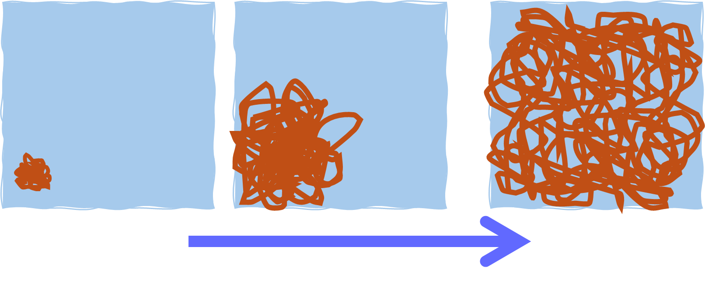
Detection – UNet CNN
MORE REWARDING
Predict infestation % (spatial spread) in a fixed location patch. A U-Net CNN can be used to achieve this.
We tried to implement this using simulated data.

Slide 16
Early Detection - GNN
MOST REWARDING
Rugulopterix Okamurae Spatio-Temporal
(ROST)
Early Detection Model

Slide 17
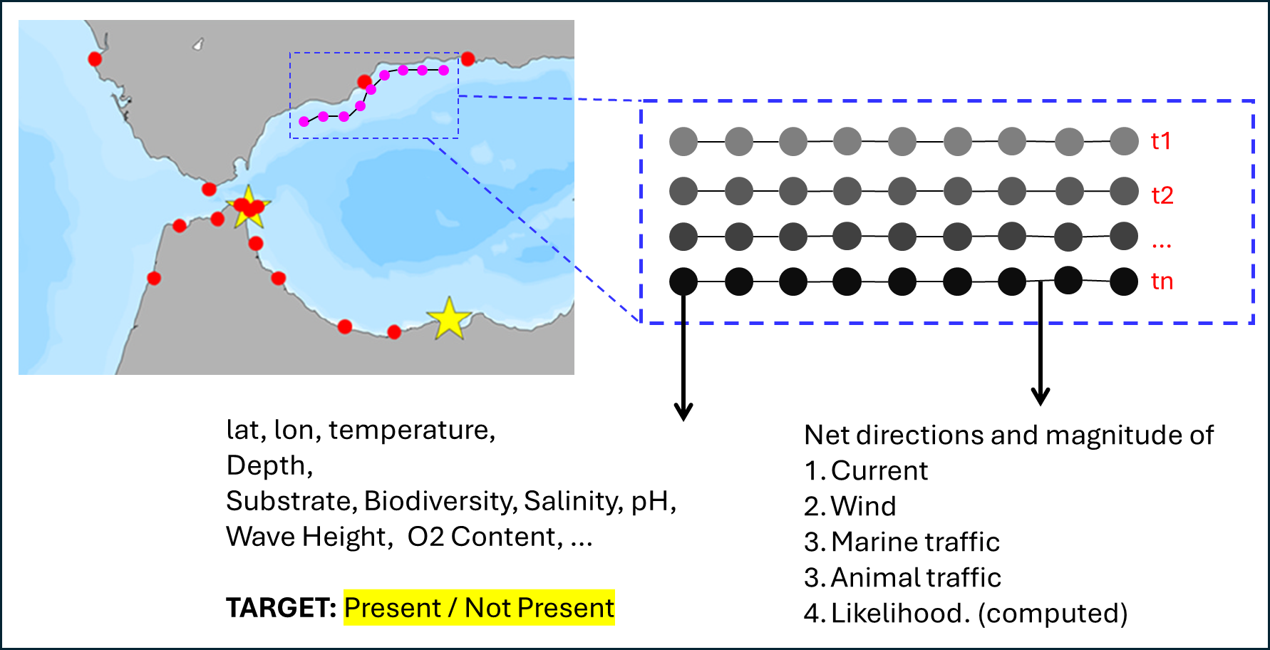

Slide 18
GNN Strategy Comparison
Variables:
Presence
Presence/absence
Potential: Coverage Index (low/medium/high)
2. Environmental Conditions
Water Temperature
Net wind direction and speed
Nutrients
Salinity
3. Linkage
Net direction and velocity of currents
Marine traffic/port proximity
Strategy | Data Source | Accuracy | Cost | Pros | Cons
Outsourced | Outsourced presence and environmental data | Medium | $ | No physical sampling necessary | Satellite data less accurate early detection Dependent on cooperating with multiple external partners
Internal sampling | Internal sampling using eDNA | Medium | $$ | Accurate presence data Work autonomously | Rely on patterns in biodiversity (eDNA) for predictability Physical sampling required
Hybrid | Internal sampling using eDNA Environmental data from databases | High | $$$ | Reliable presence and environmental data No masking necessary | Dependent on external partners. Physical sampling required

Slide 19
Conclusion and Discussion — Key Outcomes
Proposed a graph neural network based solution for early detection of R. okamurae migration.
Demonstrated feasibility of classical presence / absence detection using using a CNN and Remote Observation data.
A suitability score obtained for multiple global locations based on data analysis.
Analysis of what implementation pathways might entail.
eDNA can complement development of labelled datasets and improve input data.

Slide 20
Thank you!
From:
Gayathri Girish Nair
Yongyao Liang
Aditi Paretkar
Aidan Magee
Hafssa Najouh
Rogier Putker
Tingting Kang
Muhammad Bin Arif

